Slide 1
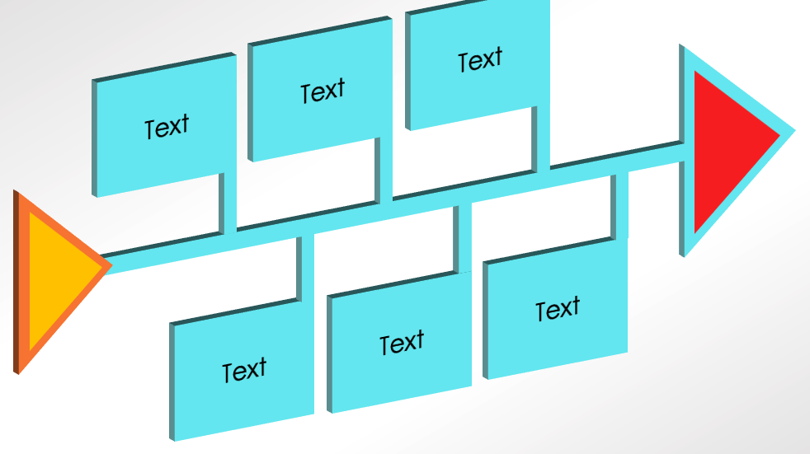
PowerPoint 3D Fishbone Diagram Template
When to Use This Template: This 3D fishbone diagram template is designed for situations where an engaging presentation is crucial, such as client pitches. Professionals in visually driven environments, such as advertising, creative industries, or education, might find it especially useful. The template is also an effective tool for team-building events where visual metaphors can enhance understanding and retention.
Notable Template Features: This template's 3D design brings a unique visual appeal to a presentation. The layout creates a natural flow, leading the audience through the analysis from the tail fins to the head, making it a practical yet aesthetically engaging tool.

Slide 2
Text
Text
Text
Text
Text
Text

Slide 3
DISCLAIMER Any articles, templates, or information provided by Smartsheet on the website are for reference only. While we strive to keep the information up to date and correct, we make no representations or warranties of any kind, express or implied, about the completeness, accuracy, reliability, suitability, or availability with respect to the website or the information, articles, templates, or related graphics contained on the website. Any reliance you place on such information is therefore strictly at your own risk.

