Slide 1
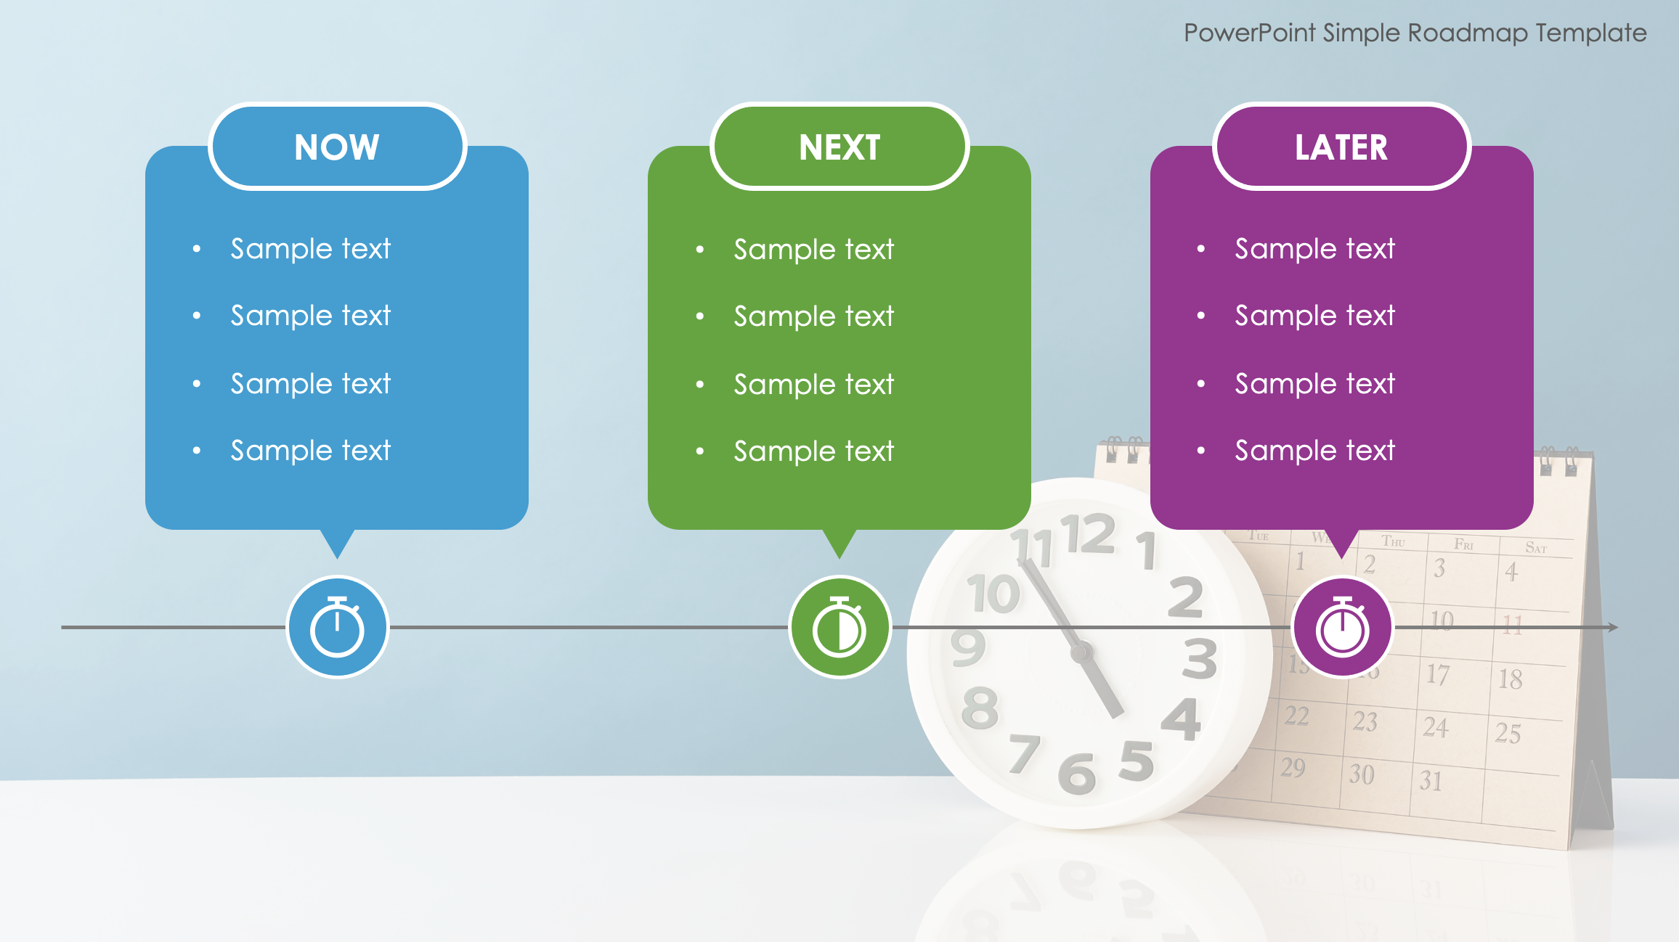
PowerPoint Simple Roadmap Template
When to Use This Template: This product roadmap template is ideal for teams that need to organize and communicate their short-term, mid-term, and long-term project plans. Product managers, development teams, and Agile coaches can use it to present on the status and upcoming priorities of their projects, as well as in sprint planning sessions, roadmapping meetings, and strategic review, to ensure everyone is aligned on immediate tasks, next steps, and future goals.
Notable Template Features: The template features three distinct sections labeled Now, Next, and Later, which provides a straightforward framework for organizing tasks and initiatives based on their timeframes. Each section contains customizable placeholders to detail specific activities, goals, or milestones, so teams can clearly visualize and prioritize their work. The color-coded boxes help to differentiate between tasks, so it’s easy to track progress and adjust plans as needed. Overall, the simple and intuitive design of this template makes it an effective tool for Agile project management and strategic planning.

Slide 2
PowerPoint Simple Roadmap Template
NOW
NEXT
LATER
Sample text
Sample text
Sample text
Sample text
Sample text
Sample text
Sample text
Sample text
Sample text
Sample text
Sample text
Sample text

Slide 3
DISCLAIMER Any articles, templates, or information provided by Smartsheet on the website are for reference only. While we strive to keep the information up to date and correct, we make no representations or warranties of any kind, express or implied, about the completeness, accuracy, reliability, suitability, or availability with respect to the website or the information, articles, templates, or related graphics contained on the website. Any reliance you place on such information is therefore strictly at your own risk.

