Slide 1

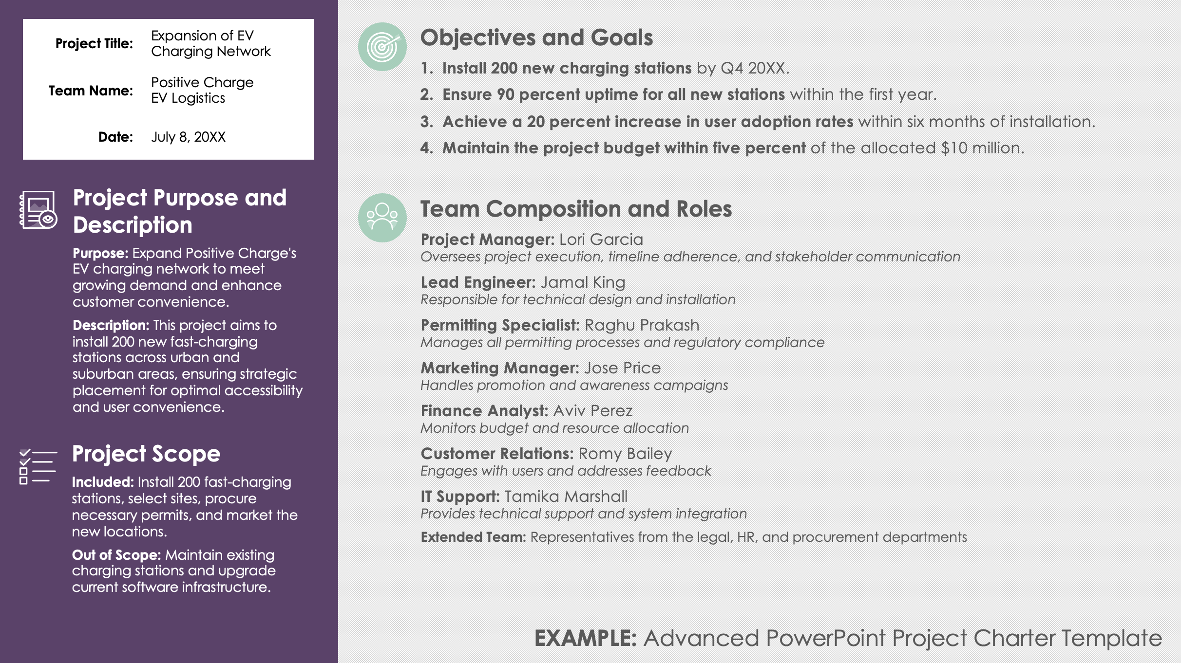
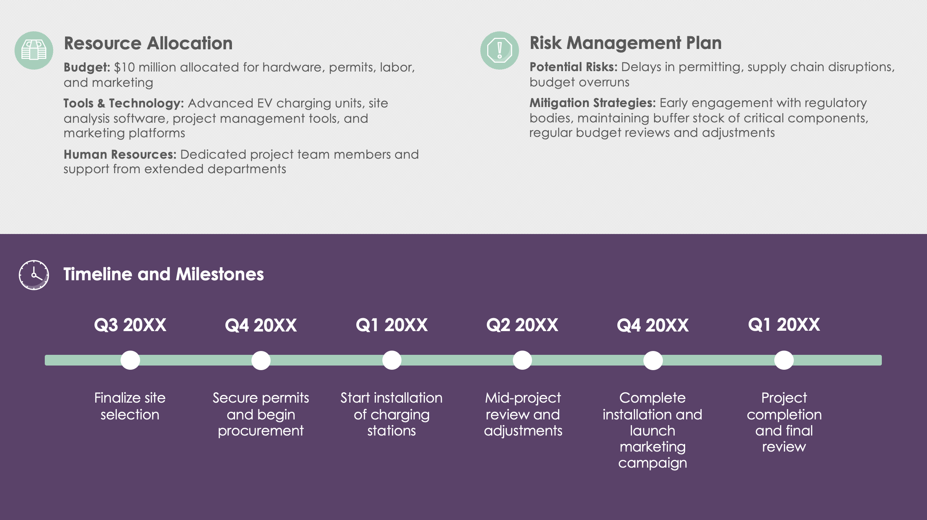
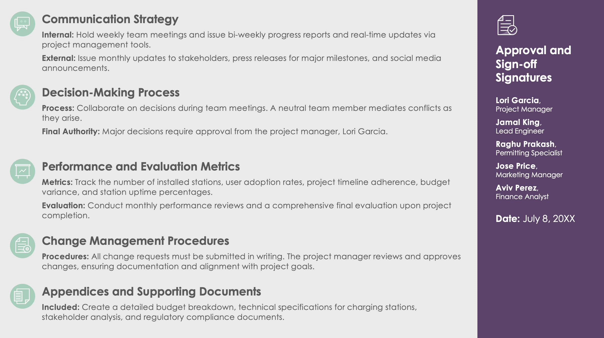
Advanced PowerPoint Project Charter Template

Slide 2




Project Title: | Title Here
Team Name: | Team Here
Date: | July 8, 20XX
Objectives and Goals
Outline specific, measurable, achievable, relevant, and time-bound (SMART) goals that the project aims to meet.
Project Purpose and Description
Purpose: Explain why the project is being undertaken.
Description: Provide a brief description of what the project aims to achieve.
Team Composition and Roles
List all team members, along with their roles, responsibilities, and contact information. This can include both core team members and extended team members from other departments.
Role/Title: Name
Responsibilities and contact information
Project Scope
Included: Detail the boundaries of the project, specifying what is included.
Out of Scope: Detail what is explicitly out of scope to prevent scope creep.
Advanced PowerPoint Project Charter

Slide 3



Resource Allocation
Detail the resources available to the team, including budget, tools, technology, and other assets necessary to complete the project.
Risk Management Plan
Identify potential risks to the project with strategies for mitigating these risks. This section helps prepare the team for possible issues and outlines how they will be handled.
Timeline and Milestones
Q3 20XX
Q4 20XX
Q1 20XX
Q2 20XX
Q3 20XX
Q4 20XX
Detailed project timeline
Key milestones
Phase completions
Critical deadlines

Slide 4






Communication Strategy
Specify the communication hierarchy and the methods by which information will be shared among team members and with external stakeholders. Detail the frequency of meetings, reports, and updates.
Approval and Sign-off Signatures
Decision-Making Process
Describe the process by which decisions will be made within the team, including how disagreements will be resolved and who has the final say in different situations.
A final slide for signatures or formal approval from key stakeholders, solidifying commitment to the charter and its terms
Name,
Title
Performance and Evaluation Metrics
Define the criteria and metrics by which the success of the project and the effectiveness of the team will be evaluated.
Date: July 8, 20XX
Change Management Procedures
Outline the procedures for managing changes to the project scope, resources, or timelines, ensuring that changes are documented and approved in a structured manner.
Appendices and Supporting Documents
Provide additional information and documents that support the project execution, such as detailed budget breakdowns, technical specifications, or stakeholder analysis.

Slide 5
Project Title: | Expansion of EV Charging Network
Team Name: | Positive Charge EV Logistics
Date: | July 8, 20XX
Objectives and Goals
Install 200 new charging stations by Q4 20XX.
Ensure 90 percent uptime for all new stations within the first year.
Achieve a 20 percent increase in user adoption rates within six months of installation.
Maintain the project budget within five percent of the allocated $10 million.
Project Purpose and Description
Purpose: Expand Positive Charge's EV charging network to meet growing demand and enhance customer convenience.
Description: This project aims to install 200 new fast-charging stations across urban and suburban areas, ensuring strategic placement for optimal accessibility and user convenience.
Team Composition and Roles
Project Manager: Lori Garcia
Oversees project execution, timeline adherence, and stakeholder communication
Lead Engineer: Jamal King
Responsible for technical design and installation
Permitting Specialist: Raghu Prakash
Manages all permitting processes and regulatory compliance
Marketing Manager: Jose Price
Handles promotion and awareness campaigns
Finance Analyst: Aviv Perez
Monitors budget and resource allocation
Customer Relations: Romy Bailey
Engages with users and addresses feedback
IT Support: Tamika Marshall
Provides technical support and system integration
Extended Team: Representatives from the legal, HR, and procurement departments
Project Scope
Included: Install 200 fast-charging stations, select sites, procure necessary permits, and market the new locations.
Out of Scope: Maintain existing charging stations and upgrade current software infrastructure.
EXAMPLE: Advanced PowerPoint Project Charter Template

Slide 6
Resource Allocation
Budget: $10 million allocated for hardware, permits, labor, and marketing
Tools & Technology: Advanced EV charging units, site analysis software, project management tools, and marketing platforms
Human Resources: Dedicated project team members and support from extended departments
Risk Management Plan
Potential Risks: Delays in permitting, supply chain disruptions, budget overruns
Mitigation Strategies: Early engagement with regulatory bodies, maintaining buffer stock of critical components, regular budget reviews and adjustments
Timeline and Milestones
Q3 20XX
Q4 20XX
Q1 20XX
Q2 20XX
Q4 20XX
Q1 20XX
Finalize site selection
Secure permits and begin procurement
Start installation of charging stations
Mid-project review and adjustments
Complete installation and launch marketing campaign
Project completion and final review

Slide 7
Communication Strategy
Internal: Hold weekly team meetings and issue bi-weekly progress reports and real-time updates via project management tools.
External: Issue monthly updates to stakeholders, press releases for major milestones, and social media announcements.
Approval and Sign-off Signatures
Decision-Making Process
Process: Collaborate on decisions during team meetings. A neutral team member mediates conflicts as they arise.
Final Authority: Major decisions require approval from the project manager, Lori Garcia.
Lori Garcia,
Project Manager
Jamal King,
Lead Engineer
Raghu Prakash,
Permitting Specialist
Jose Price,
Marketing Manager
Aviv Perez,
Finance Analyst
Performance and Evaluation Metrics
Metrics: Track the number of installed stations, user adoption rates, project timeline adherence, budget variance, and station uptime percentages.
Evaluation: Conduct monthly performance reviews and a comprehensive final evaluation upon project completion.
Date: July 8, 20XX
Change Management Procedures
Procedures: All change requests must be submitted in writing. The project manager reviews and approves changes, ensuring documentation and alignment with project goals.
Appendices and Supporting Documents
Included: Create a detailed budget breakdown, technical specifications for charging stations, stakeholder analysis, and regulatory compliance documents.

Slide 8
DISCLAIMER Any articles, templates, or information provided by Smartsheet on the website are for reference only. While we strive to keep the information up to date and correct, we make no representations or warranties of any kind, express or implied, about the completeness, accuracy, reliability, suitability, or availability with respect to the website or the information, articles, templates, or related graphics contained on the website. Any reliance you place on such information is therefore strictly at your own risk.

